Slide 1
To do
Sql pitfalls
Resources
Subqueries from sql learning
Demo using mode or psql or pgadmin4
Datacamp projects
Subquery vs. JOIN | LearnSQL.com
https://learnsql.com/blog/subquery-vs-join/
SQL for Data Analysis: Subquery vs. CTE | by Aaron Zhu | Towards Data Science
https://towardsdatascience.com/sql-for-data-analysis-subquery-vs-cte-699ef629d9eb
“Common Table Expression(CTE) in SQL Server” | by Smita Gudale | Medium
https://medium.com/@smitagudale712/common-table-expression-cte-in-sql-server-c6dfb8a461ee
How to use CTEs in SQL. How to use a Common Table Expression to… | by Jason Lee | Towards Data Science
https://towardsdatascience.com/using-ctes-to-improve-sql-queries-dfcb04b7edf0
Basic SQL Techniques For Data Analysis | by Ektamanvar | Mar, 2022 | Medium
https://ektamanvar23.medium.com/sql-techniques-for-data-analysis-92d85de3c32a
Window Functions in SQL: Aggregating Values | by Michael Grogan | Towards Data Science
https://towardsdatascience.com/window-functions-in-sql-aggregating-values-278f2bdb545
Common Table Expressions: When and How to Use Them | Tutorial by Chartio
https://chartio.com/resources/tutorials/using-common-table-expressions/
MySQL | Recursive CTE (Common Table Expressions) - GeeksforGeeks
https://www.geeksforgeeks.org/mysql-recursive-cte-common-table-expressions/
What if ... you had to use parameters in SQL queries - Castor Blog
https://www.castordoc.com/blog/what-if-you-had-to-use-parameters-in-sql-queries

Slide 2
Data Analyst Nanodegree
Session 2
Conducted by: Hamza
Notes:
https://udacity.zoom.us/j/7991233356
<number>

Slide 3
Agenda
Joins
Subquery
CTEs
Analytic/window functions
Project

Slide 4
Slack / SUPPORT / REPOs
https://join.slack.com/t/egfwd-t3-march-22/shared_invite/zt-146jjry1h-VrWow3RuYnZ1bk~ZUyrPzg
fwd-support@udacity.com
https://github.com/santarabantoosoo/Data-Analysis-NanoDegree-2.0
Notes:
<number>

Slide 5


Slide 6
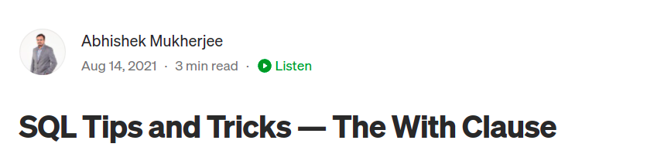
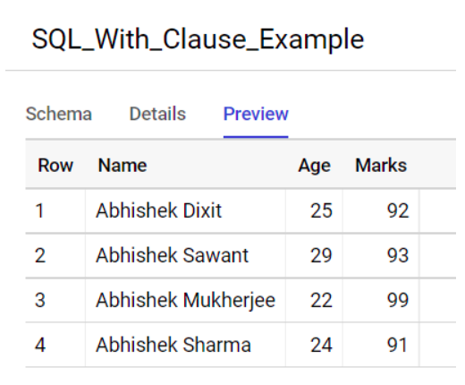
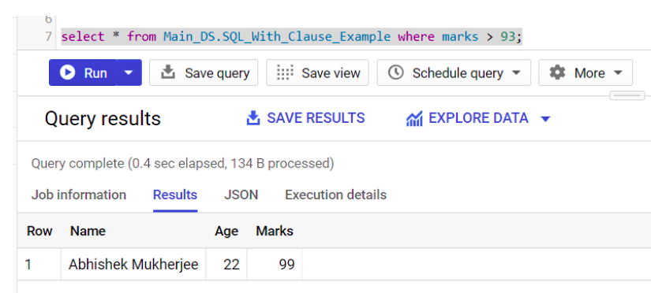
https://medium.com/@abhishekblogger/sql-tips-and-tricks-the-with-clause-1a78af758af7

Slide 7
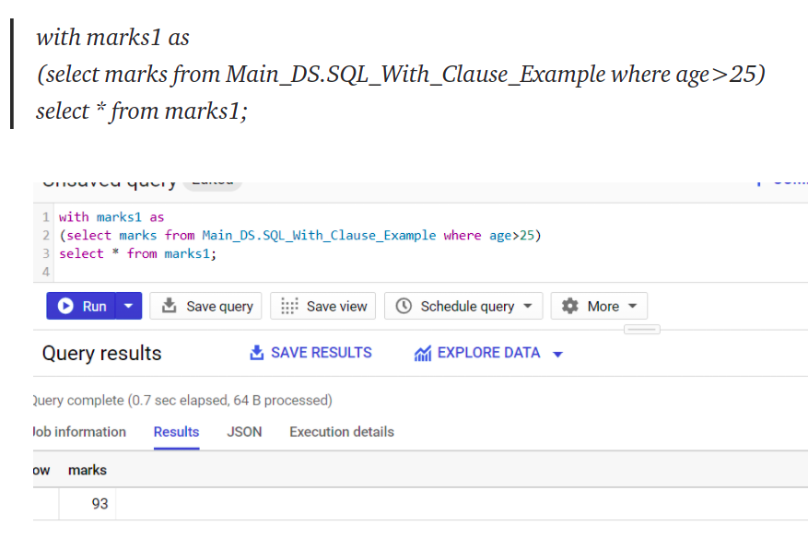
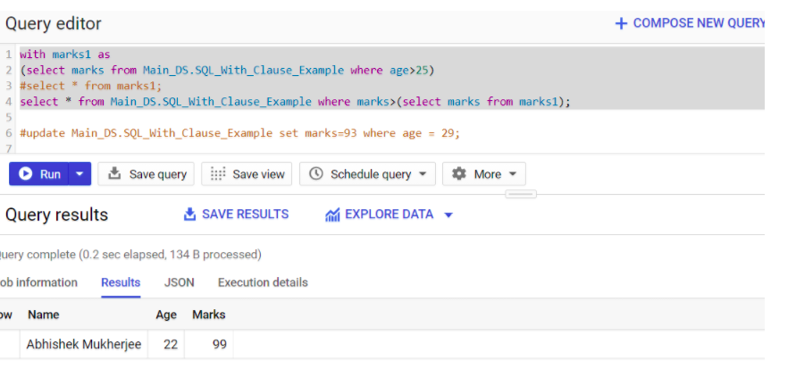

Slide 8
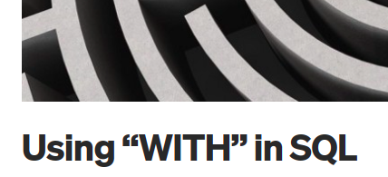
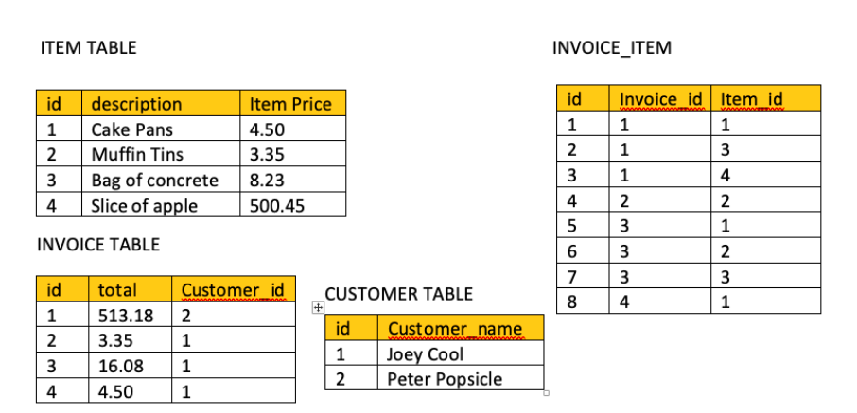
How many invoices are associated with the customer Joey Cool and how many of each item did he purchase?
https://medium.com/@jeremiahlutes/using-with-in-sql-10617d0a1d0c

Slide 9
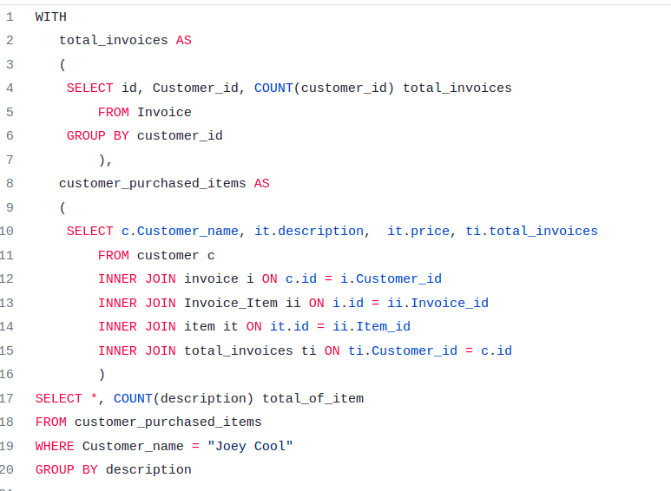

Slide 10
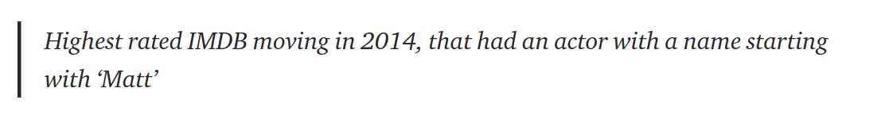
Good example
https://towardsdatascience.com/using-ctes-to-improve-sql-queries-dfcb04b7edf0

Slide 11
Consider adding case statements from SQL intermediate course datacamp

Slide 12
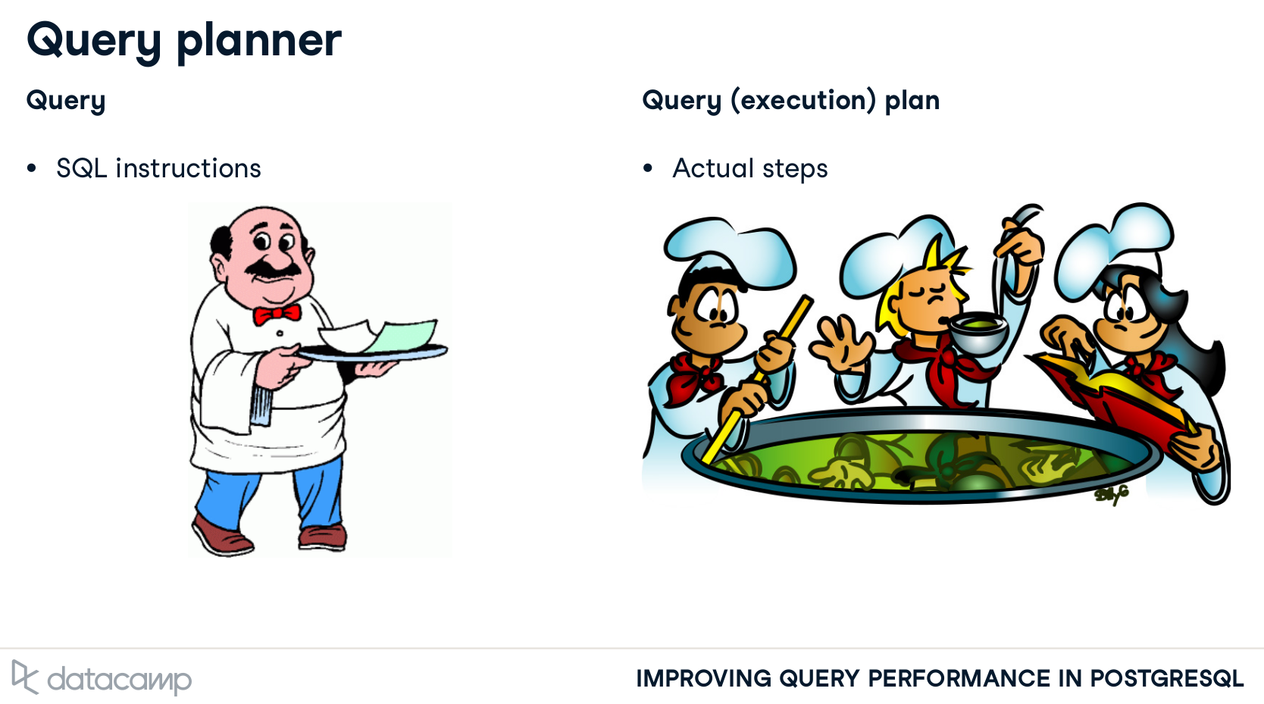
U ORDER – planner optimizes
لو خنقته - هيخنقك

Slide 13
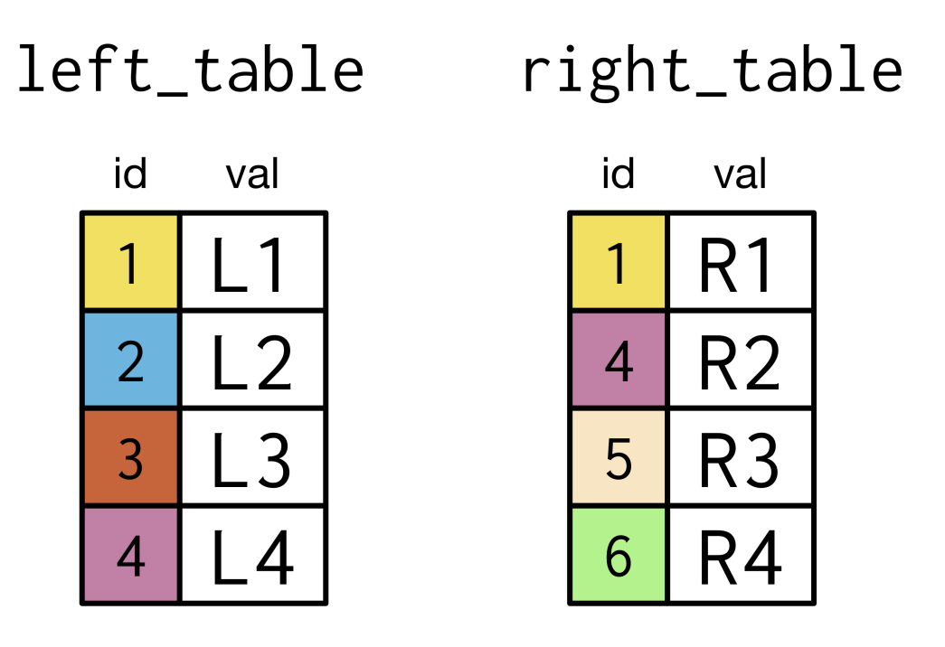
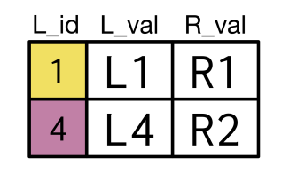
Joins
Which join type?

Slide 14
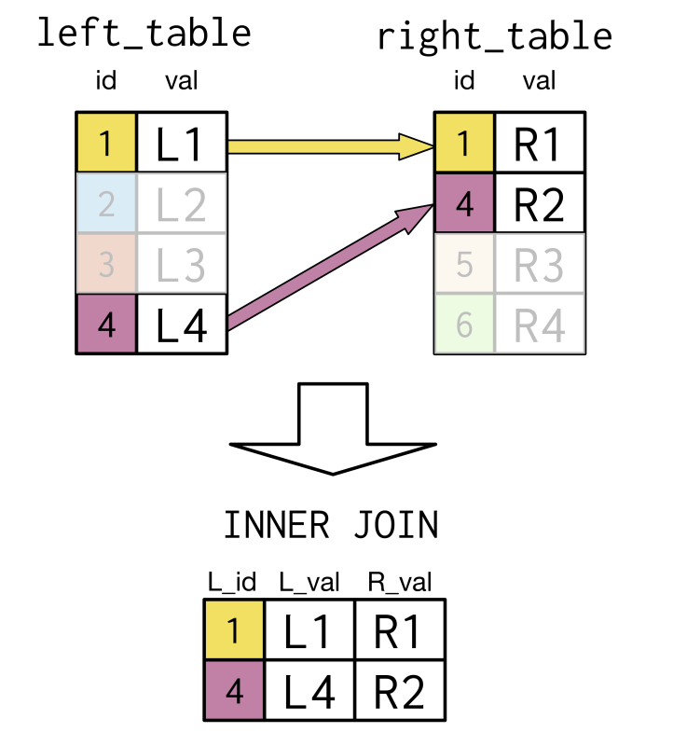
Solution

Slide 15
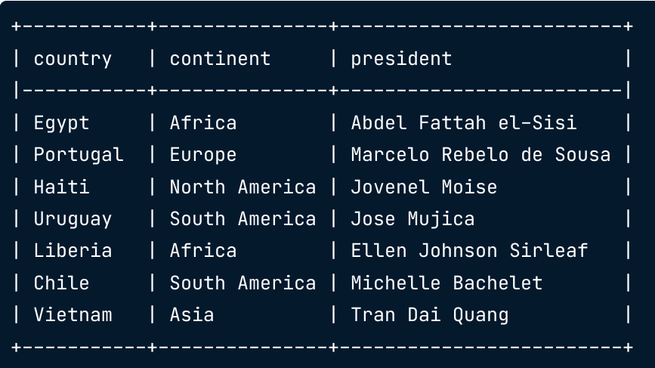
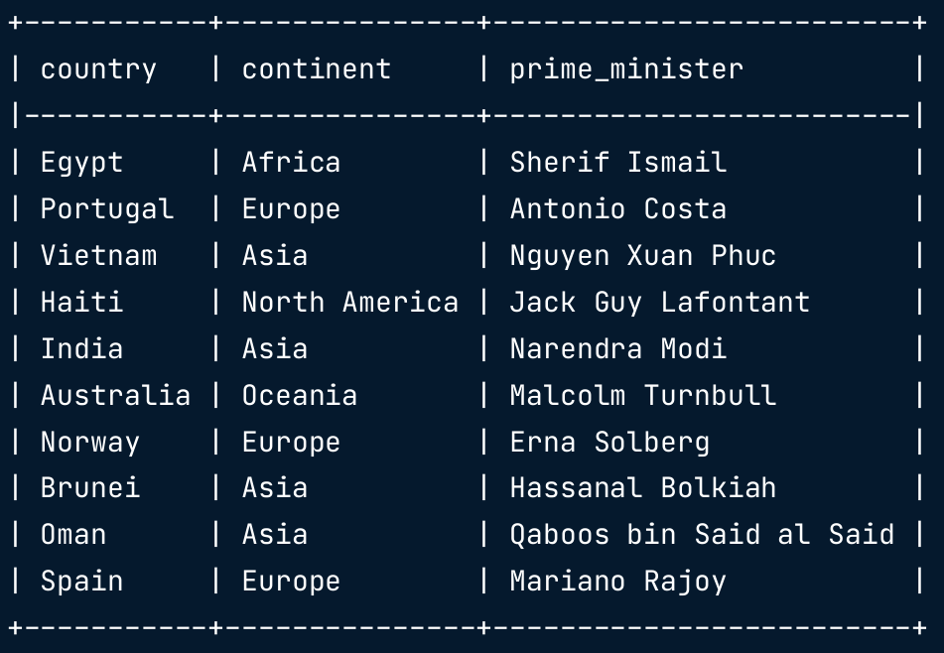
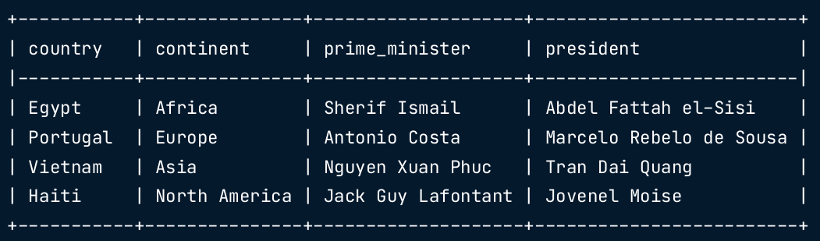
How to join?

Slide 16
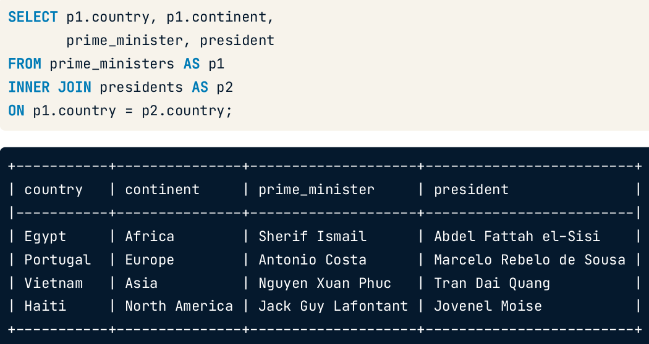
Solution
Other solutions?

Slide 17
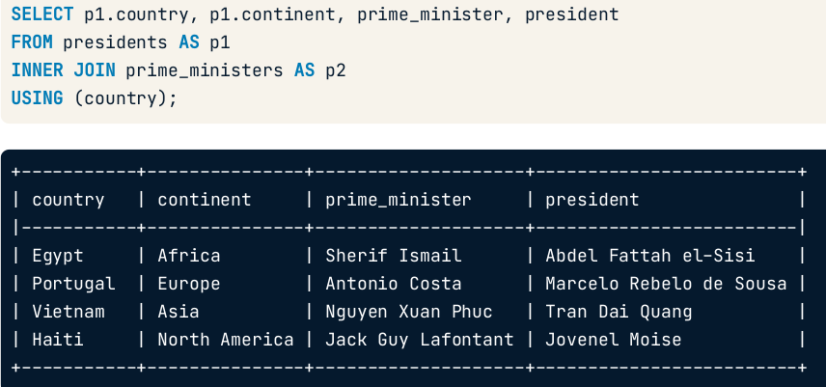
Using?
When will it fail?

Slide 18
Using?
Different spelling
When will it fail?

Slide 19
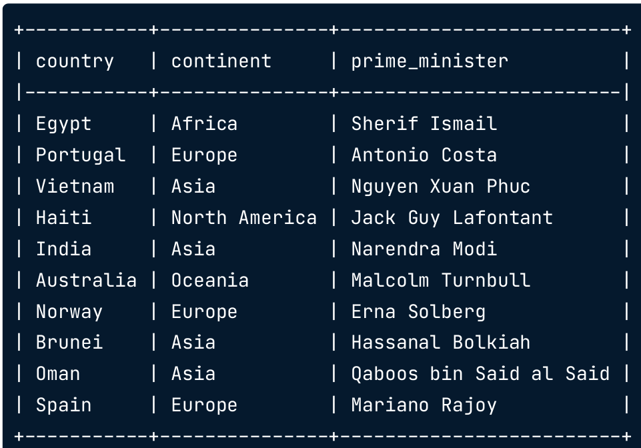
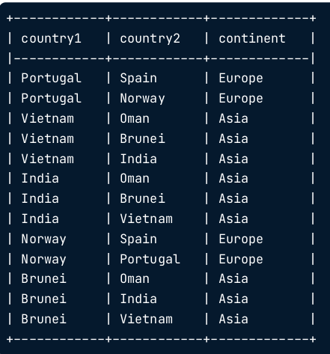
How to get there?

Slide 20
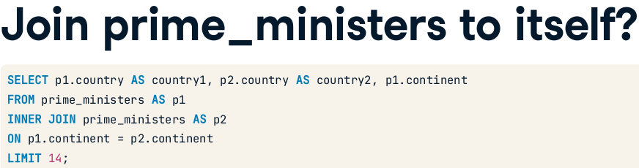
Solution
Anything missing?

Slide 21
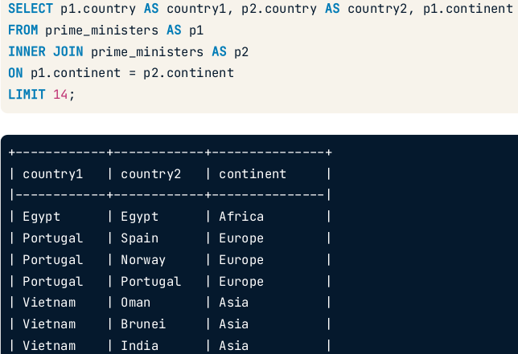
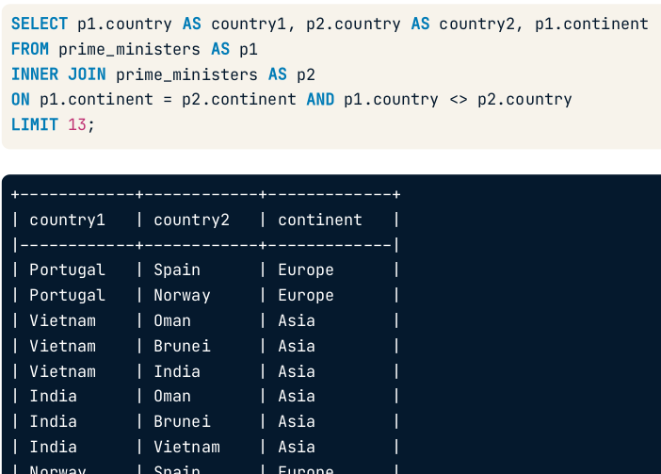
Self-join
No repetition!

Slide 22
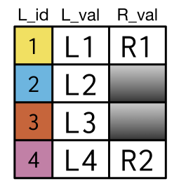
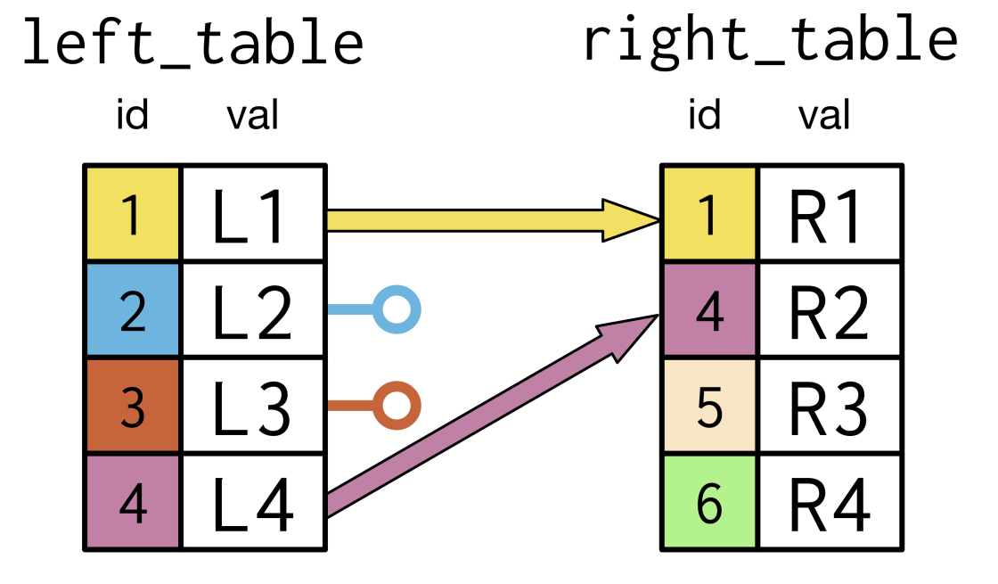
Which join?

Slide 23
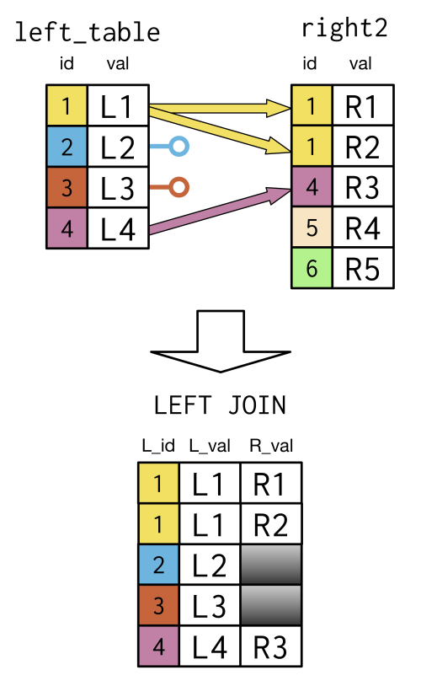
Solution

Slide 24
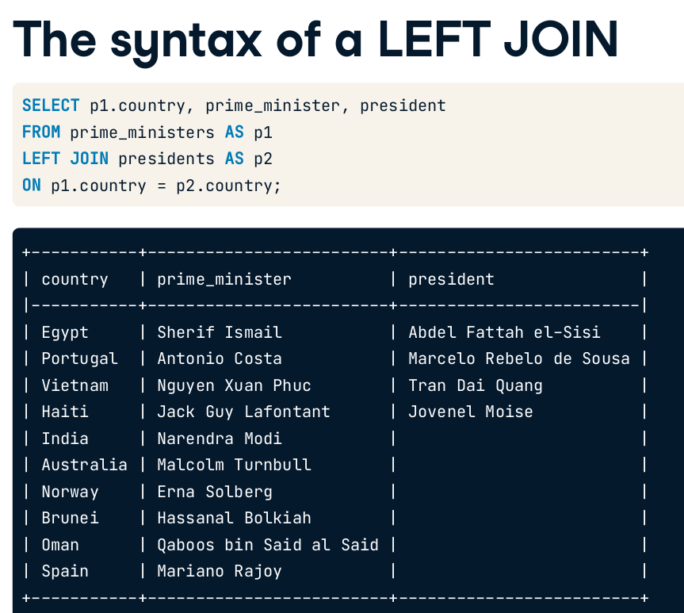
Notice the NULLs

Slide 25
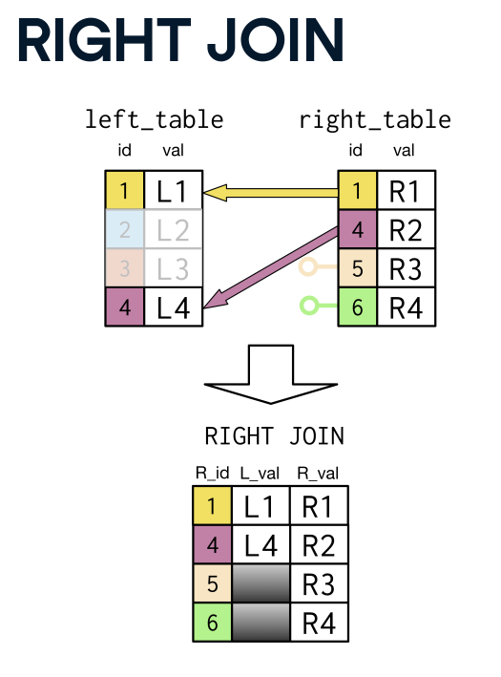
Familiar?

Slide 26
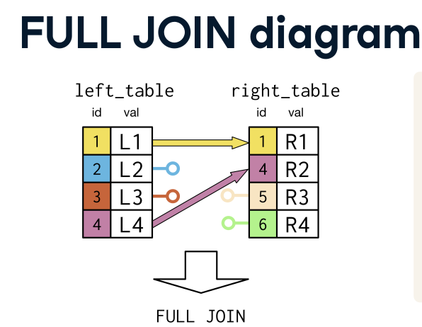
What to expect?
How many columns? rows? NULLs?

Slide 27
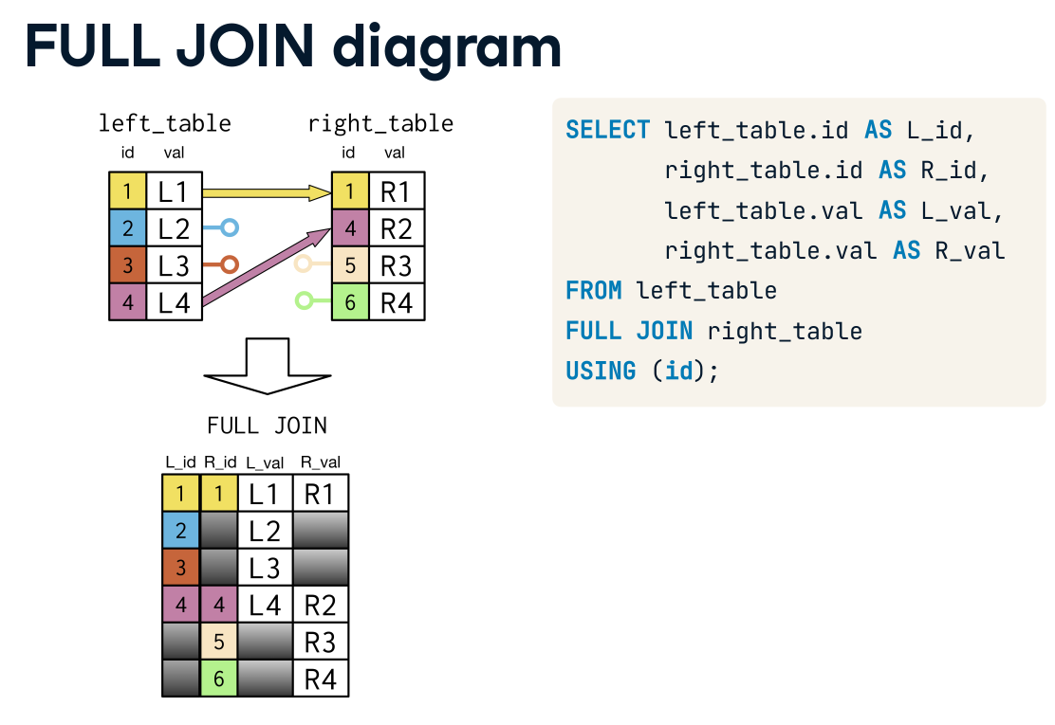
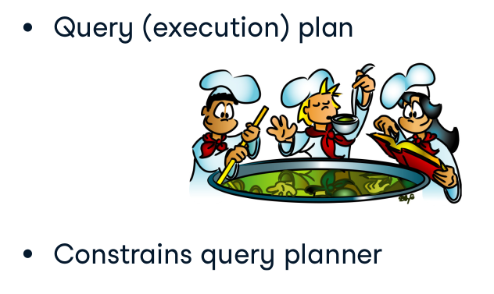
FULL JOIN = FULL OUTER JOIN

Slide 28
Full join?

Slide 29
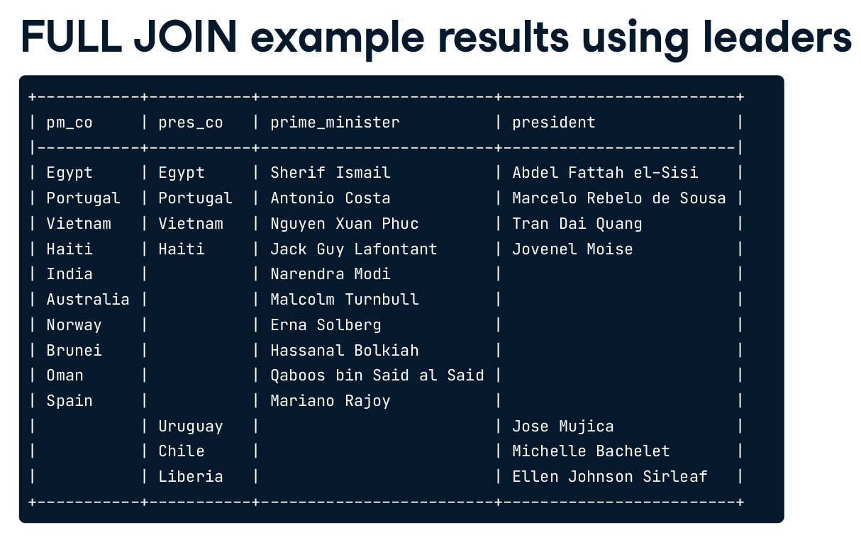
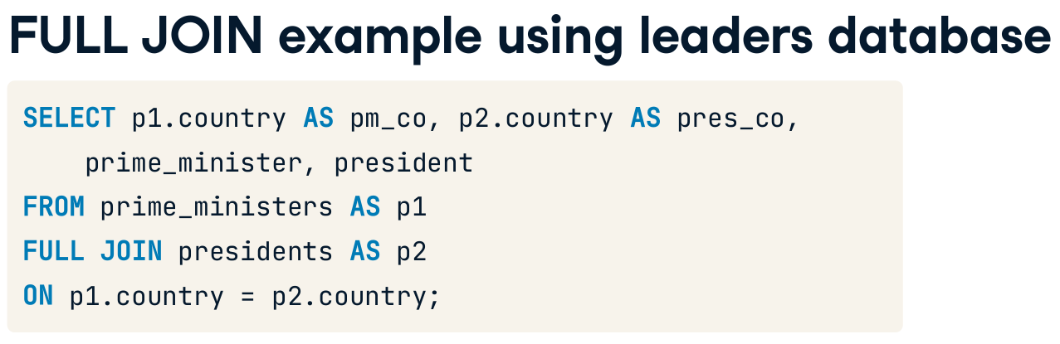
Solution

Slide 30
What if?
Each president should meet each prime minister?

Slide 31
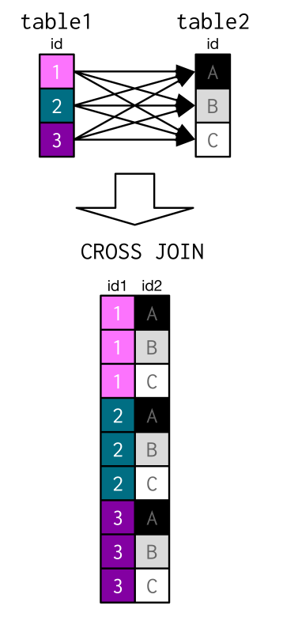
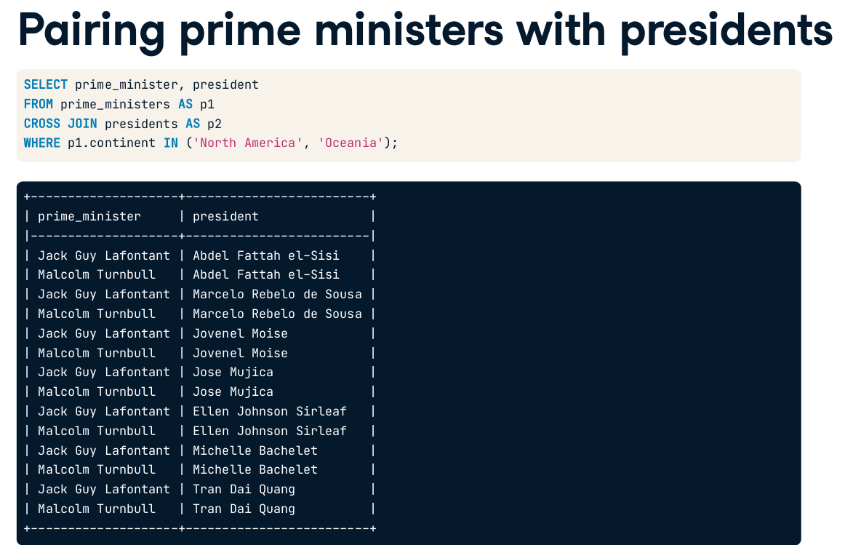
Cross join

Slide 32
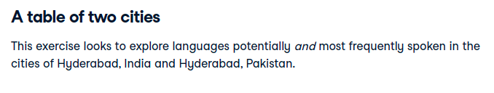
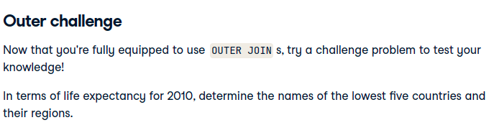
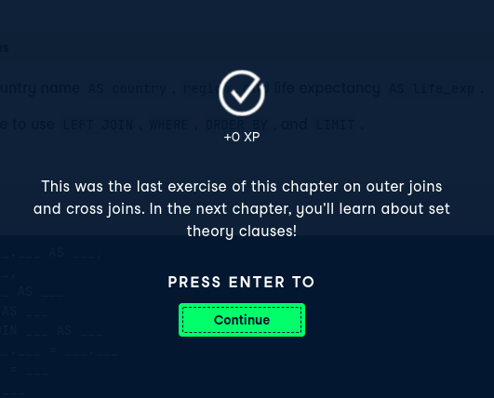
Challenge!
https://campus.datacamp.com/courses/joining-data-in-sql/outer-joins-and-cross-joins?ex=12

Slide 33
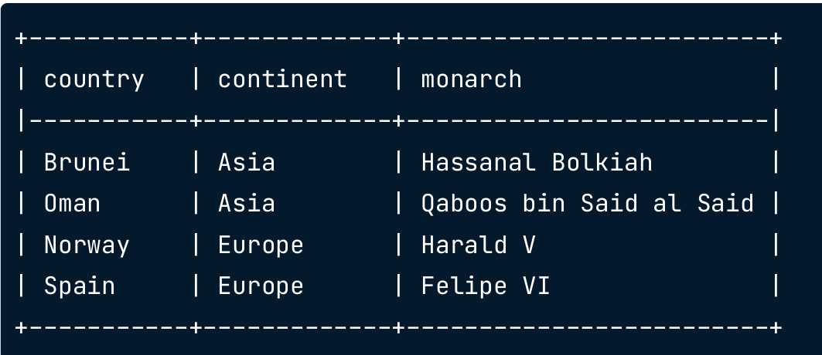
How to combine?

Slide 34
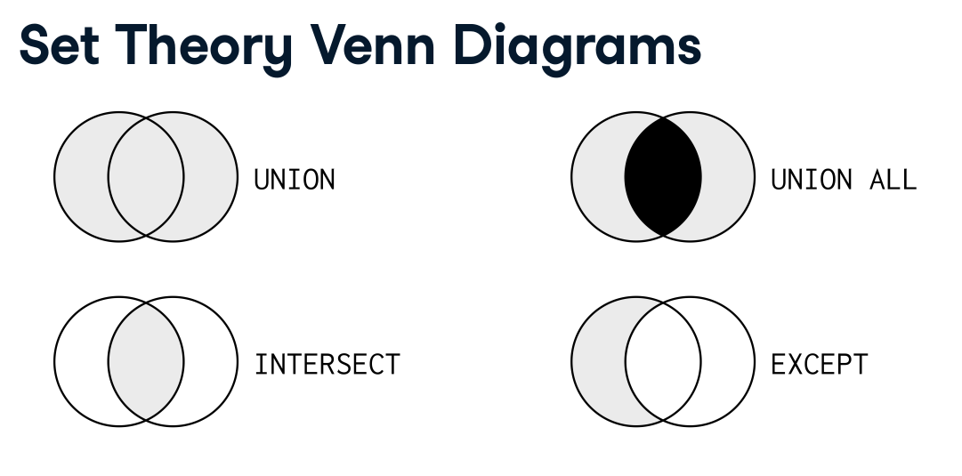

Slide 35
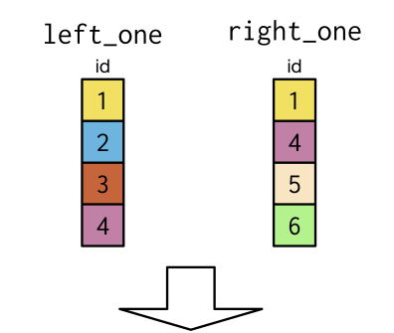
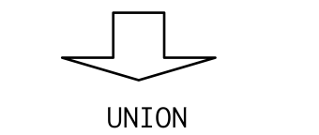

Any difference?

Slide 36
How to combine?

Slide 37
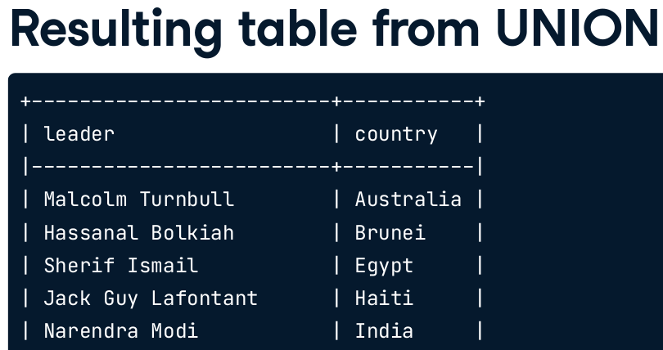
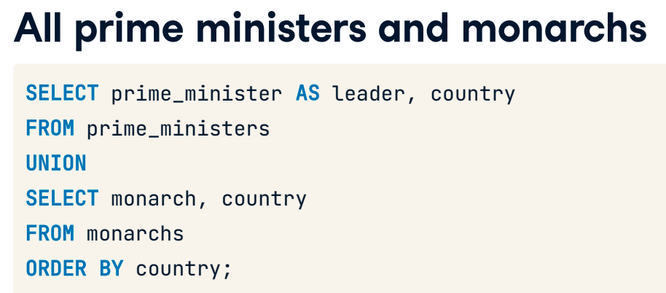
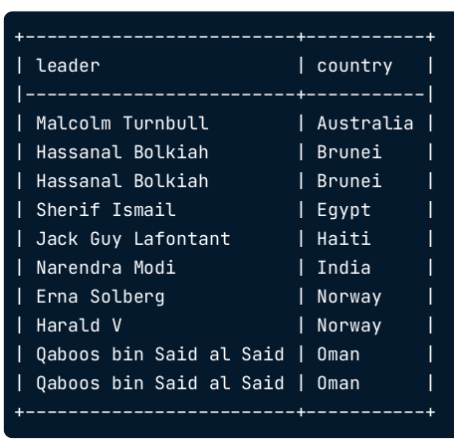
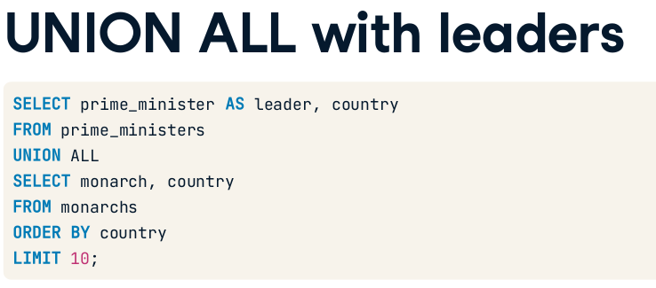

Slide 38
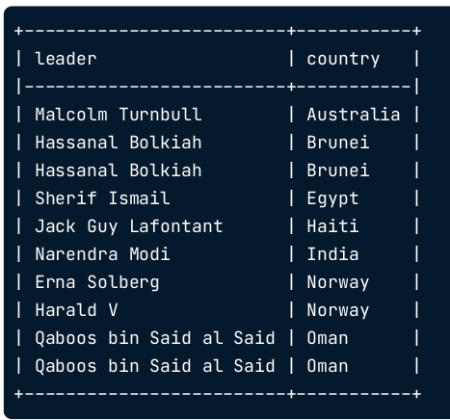
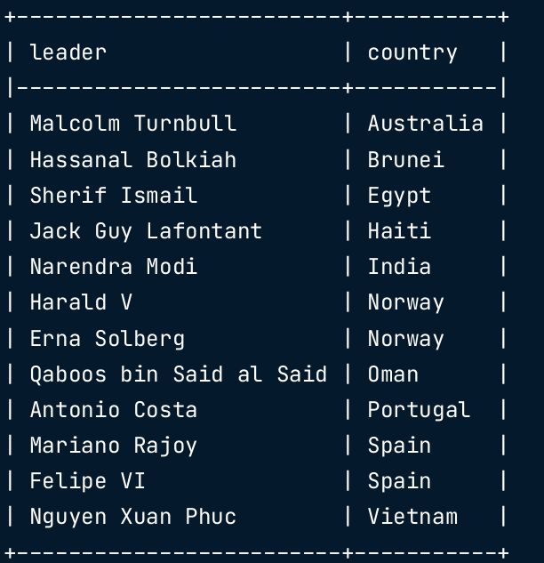
UNION VS UNION ALL?

Slide 39
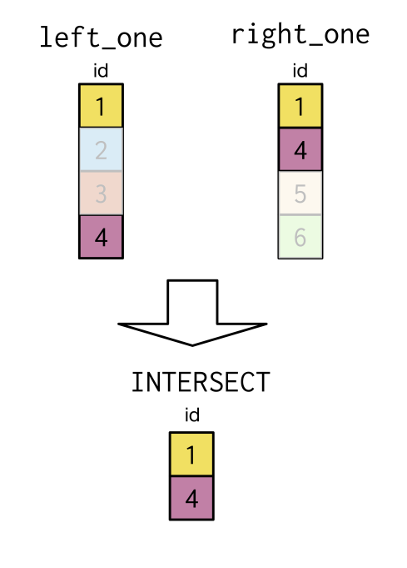

Slide 40
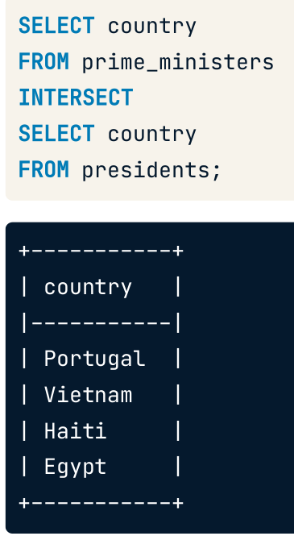

Why is that?

Slide 41
Why is that?
Selects countries that have both p and pm
Both p and pm with same name

Slide 42


EXCEPT

Slide 43
What joins and sets did we use?
Inner
Self
Left
Right
Outer
cross
Union
Union all
Intersect
Except

Slide 44


How to solve?
Select from left table, countries that had independence before 1800

Slide 45


Slide 46


Slide 47

Connecting the dots

Slide 48


Anti-join

Slide 49

Recap

Slide 50

Small steps again
Find Asian countries below average `fert_rate`

Slide 51


2 small steps
Output of inner query?
Notes:
scalar

Slide 52

Combine!

Slide 53

Conclusion

Slide 54


Slide 55

Use cases

Slide 56


For each season, get the number of matches. Compare this to a column that has the overall number of matches

Slide 57

For each season, get the number of matches. Compare this to a column that has the overall number of matches

Slide 58


Manual solution

Slide 59

Automatic solution?
Can we do even better?

Slide 60
Use cases

Slide 61


What is the expected output?
For season 2011/2012, get total goals for each match and get the deviation from the overall average for same season.

Slide 62

How to solve?
For season 2011/2012, get total goals for each match and get the deviation from the overall average for same season.
Expected output

Slide 63


Hardcoded or automatic?
What if we removed the 2nd WHERE?

Slide 64

challenge
https://campus.datacamp.com/courses/intermediate-sql/short-and-simple-subqueries?ex=9
https://campus.datacamp.com/courses/intermediate-sql/short-and-simple-subqueries?ex=10

Slide 65


Slide 66
How to solve?
maximum percentage of women in parliament for each continent listed in monarchs table.

Slide 67

Step1
From 2 tables?

Slide 68

Step 2
Duplicates?
Max perc?

Slide 69

Done
How did we decide which table should be the inner?
Is it
?
Notes:
I think it makes sense to get the distinct continents in the outer query. Then match each average to it later from the subquery.
In addition, if we did it the opposite way, the group by would be in the outer query.
In fact I am not sure

Slide 70

In the query execution plan, subqueries in SELECT and WHERE statements are analogous to joins, unlike FROM.

Slide 71



https://asktom.oracle.com/pls/apex/asktom.search?tag=regarding-subquery-terminology
https://learnsql.com/blog/inline-query-in-sql/#:~:text=The%20first%20difference%20is%20that,work%20as%20a%20single%20value.

Slide 72

Spare the first part

Slide 73




Slide 74



Common Table expressions
Notes:
Also named as
<number>

Slide 75


With clause
WHERE / SELECT / FROM ??
Notes:
WITH clauses allow us to improve the structure of an SQL statement without polluting the database namespace.
As far as I understand, where is not possible.
SELECT is possible only with correlated subquery. (slow)
<number>

Slide 76



GET AVG
JOIN
FROM?

Slide 77

GET AVG
JOIN
Drawbacks?

Slide 78

SOLUTION
GET AVG
JOIN

Slide 79

OUTPUT

Slide 80

Basic syntax

Slide 81

Comparison

Slide 82
Multiple with clauses
+ location
Notes:
WITH clauses allow us to improve the structure of an SQL statement without polluting the database namespace.
As far as I understand, where is not possible.
SELECT is possible only with correlated subquery. (slow)
<number>

Slide 83

Notes:
WITH clauses allow us to improve the structure of an SQL statement without polluting the database namespace.
As far as I understand, where is not possible.
SELECT is possible only with correlated subquery. (slow)
<number>

Slide 84



One solution

Slide 85

Alternative solution
12 lines
17 lines

Slide 86





Slide 87


Slide 88



https://www.youtube.com/watch?v=Gm8N_yip0Ek
Window function?
Notes:
The same result can be obtained with window SQL functions and just one CTE, but we used multiple common table expressions here.

Slide 89
Nested with clauses
AVG salaries + Minimum of AVG salaries
Notes:
WITH clauses allow us to improve the structure of an SQL statement without polluting the database namespace.
As far as I understand, where is not possible.
SELECT is possible only with correlated subquery. (slow)
<number>

Slide 90

Nested with clauses
Role with minimum of AVG salaries
Notes:
WITH clauses allow us to improve the structure of an SQL statement without polluting the database namespace.
As far as I understand, where is not possible.
SELECT is possible only with correlated subquery. (slow)
<number>

Slide 91

Nested with clauses
Role with minimum of AVG salaries
Notes:
WITH clauses allow us to improve the structure of an SQL statement without polluting the database namespace.
As far as I understand, where is not possible.
SELECT is possible only with correlated subquery. (slow)
<number>

Slide 92


Table Creation vs. CTEs

Slide 93

More info
https://learnsql.com/blog/with-clause-is-awesome-sql/
Notes:
The WITH clause was introduced in SQL:1999 to define views that are only valid for the query they belong to.

Slide 94

Common Table Expression(CTEs)
better when working with large or complex tables that are resource intensive to query.
What a temp table?

Slide 95

Temp table
What about CTEs?

Slide 96

Convert to temp

Slide 97


Slide 98


Slide 99

Materialize a view!

Slide 100
Common Table Expression(CTEs)
better when working with large or complex tables that are resource intensive to query.
Materialize a view!

Slide 101


How many records
Words in script
Words in dictionary
Join and get the average word length

Slide 102

Alternative solution

Slide 103

Spare this – till u identify

